Slide 1
Introduction to Machine Learning
Lesson 19.1

Slide 2
Class Objectives
By the end of this lesson, you will be able to:
Recognize the differences between supervised and unsupervised machine learning (ML).
Define clustering and how it is used in data analytics.
Apply the K-means algorithm to identify clusters in a given dataset.
Use the elbow method to determine the optimal number of clusters for a dataset.

Slide 4
Demystifying Machine Learning

Slide 5
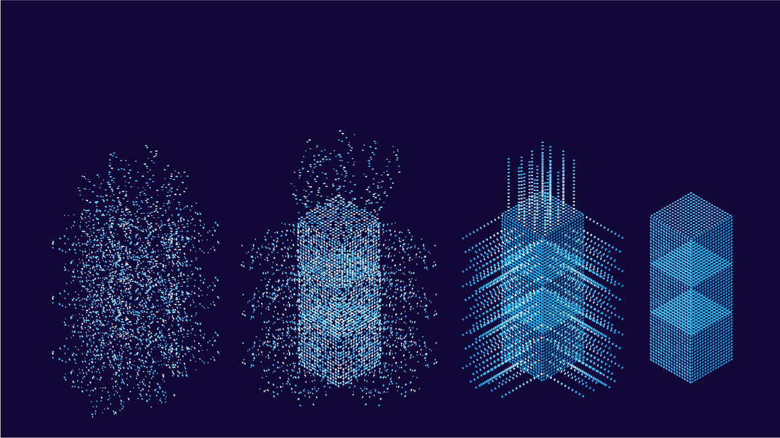
Machine learning is the practice of applying computer algorithms and statistics to create models that can learn from data and then make decisions or predictions about future data.
Notes:
shutterstock_1095077426_data

Slide 6

Today, machine learning is changing industries at an unprecedented pace.
Machine learning allows for decisions to be made more quickly and efficiently than ever before.
Notes:
shutterstock_2107445762

Slide 7


This Week’s Challenge Assignment
Create a machine learning model that groups cryptocurrencies to assemble investment portfolios that are based on the profitability of those cryptocurrencies.

Slide 8
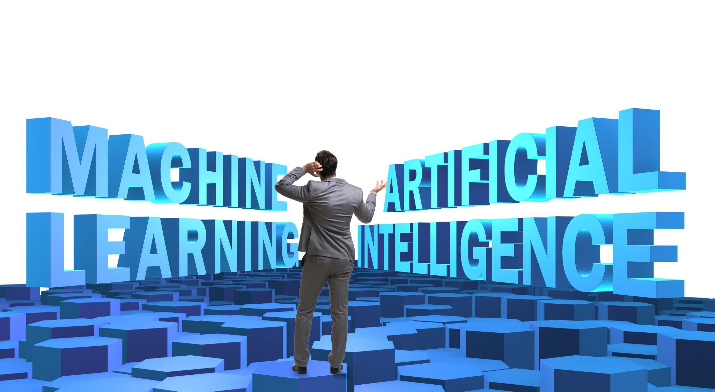
The Mysticism of Machine Learning
Despite the mainstream use of the term “machine learning,” most people still don't know what machine learning really is.
Notes:
shutterstock_1450715714

Slide 9
Machine learning is the practice of applying computer algorithms and statistics to create models that can learn from past data and then make decisions or predictions about future data.

Slide 10
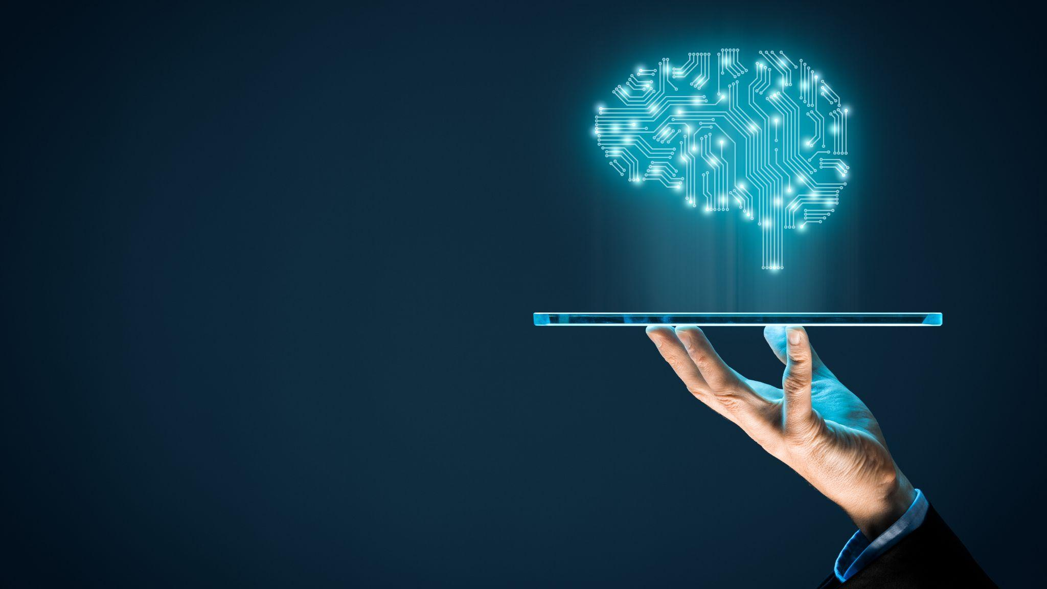
Machine Learning
Algorithms learn how to make decisions without needing anyone to program the logic directly.
They learn the patterns, behavior, and relationships on their own directly from the data, and then they use that knowledge to make decisions and predictions.
Notes:
shutterstock_776025448

Slide 11
Here’s an example of how machine learning can be useful…

Slide 12

Machine Learning
Imagine that you work as a fraud analyst in a bank, and you want to identify fraudulent transactions.
Option 1
Option 2
Create a 5,000-line if-else decision structure that evaluates every price range and product category to determine if a transaction counts as fraudulent.
Use machine learning algorithms to review all of the transactions that an account owner has ever made.
Then, you can group the transactions and predict whether the most recent transaction counts as fraudulent.
This is the kind of machine learning solution that you’ll learn to build!

Slide 13
Why is machine learning essential for data analytics?

Slide 14
Machine Learning in Data Analytics
Applications for machine learning vary widely, but all share the common goals of making more efficient decisions, predictions, and products.
Machine learning applications have streamlined operational processes across many industries.
Incorporating machine learning has helped businesses dramatically improve responsiveness to customer demands.

Slide 15
What are some examples of machine learning models that you’ve heard of?

Slide 16
Types of ML
Examples include:
Regression
Clustering
Neural networks
Deep learning

Slide 17

Types of ML
We can group all of these models into two main buckets:
01
Supervised learning
02
Unsupervised learning
The algorithm learns on a labeled dataset, where each example in the dataset is tagged with the answer.
This provides an answer key that can be used to evaluate the accuracy of the training data.
The algorithm tries to make sense of an unlabeled dataset by extracting features and patterns on its own.

Slide 18
Supervised Learning vs. Unsupervised Learning Unsupervised Learning
Supervised Learning
Unsupervised Learning
vs.
x₂
x₂
x₁
x₁

Slide 19


Reinforcement Learning
This third type of machine learning algorithm is used less frequently but still has important applications in data analytics.
Environment
The agent again observes the current environment.
State
Reward
The agent observes its environment, takes an action.
Agent
It then measures how closely that action took it to completing a task.
Action
https://perfectial.com
Notes:
shutterstock_1181720482

Slide 20
Three Types of ML
Machine Learning
Supervised
Unsupervised
Reinforcement
Task driven
(Predict next value)
Data driven
(Identify clusters)
Learn from mistakes
https://perfectial.com

Slide 21

Types of ML
Fraud detection
Image classification
Customer retention
Credit approval
Targeting customer ads
Dimensionality Reduction
Feature discernment
Structure discovery
Big data visualization
Classification
Unsupervised Learning
Supervised Learning
Machine Learning
Clustering
Recommendation systems
Targeted marketing
Customer segmentation
Regression
Population growth prediction
Predicting financial returns
Weather forecasting
Forecasting real estate prices
Reinforcement Learning
Real-time decisions
Learning tasks
Skill acquisition
Algorithmic trading

Slide 22
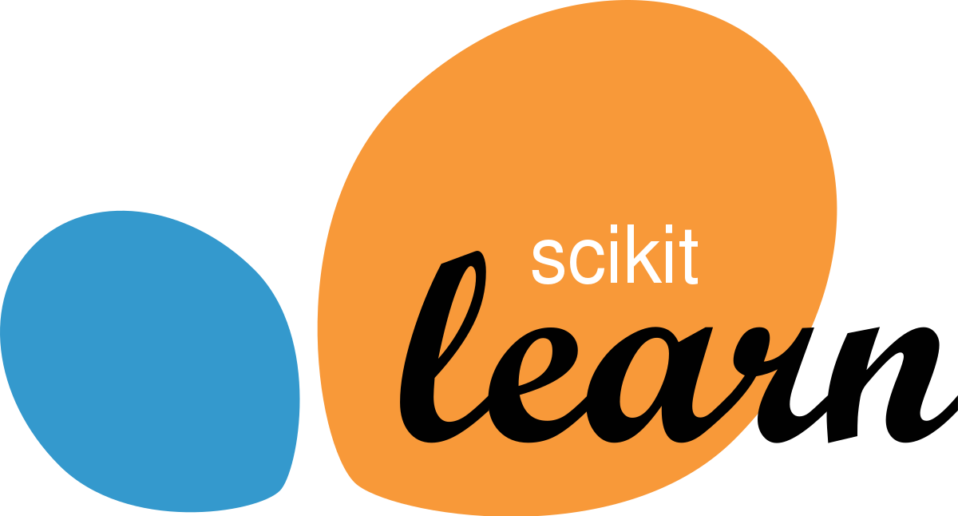






Types of ML
Most Python libraries for machine learning use a common interface to build and use machine learning models.

Slide 24
Machine Learning Is Awesome
Notes:
2. Instructor Do: Machine Learning Is Awesome (10 minutes

Slide 25
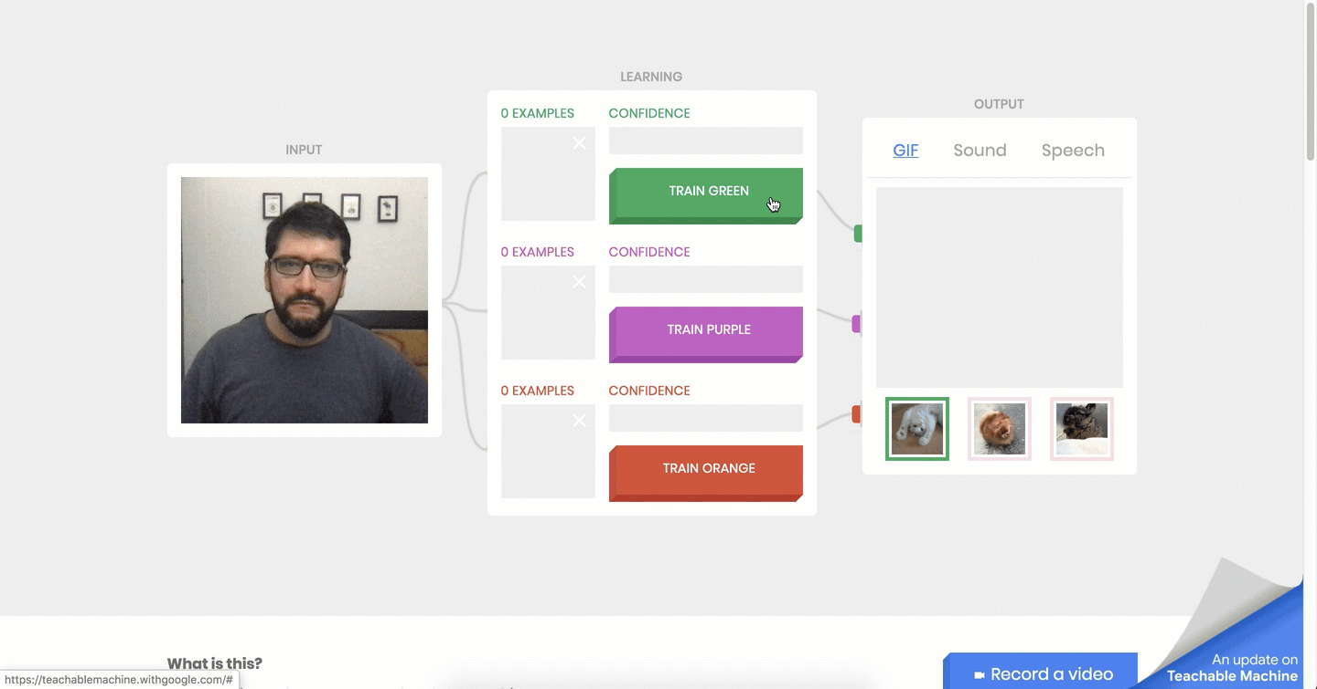
Teachable Machine in Action
The Teachable Machine project from Google shows the fundamental mechanism of a neural network by training a model that recognizes gestures from your webcam to predict one of three classes.

Slide 26
Introduction to Unsupervised Learning
Notes:
3. Instructor Do: Introduction to Unsupervised Learning (15 minutes)

Slide 27
Unsupervised learning algorithms use test data to construct models that categorize relationships among data points.

Slide 28
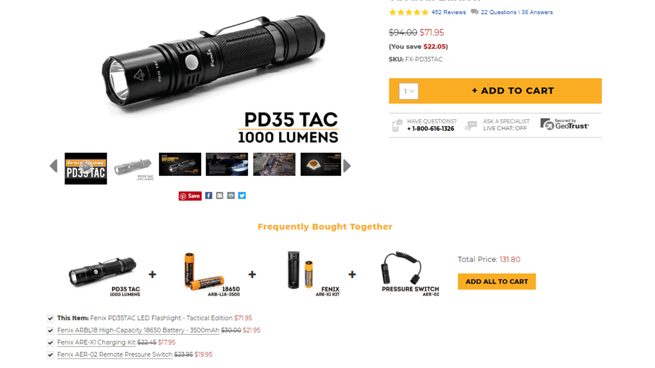
Introduction to Unsupervised Learning
For example, when you’re reviewing a particular item for purchase on a website, unsupervised learning algorithms might be used to identify related items that are frequently bought together.
This power to recognize data patterns has broad applications in data analytics.
https://www.bigcommerce.com

Slide 29
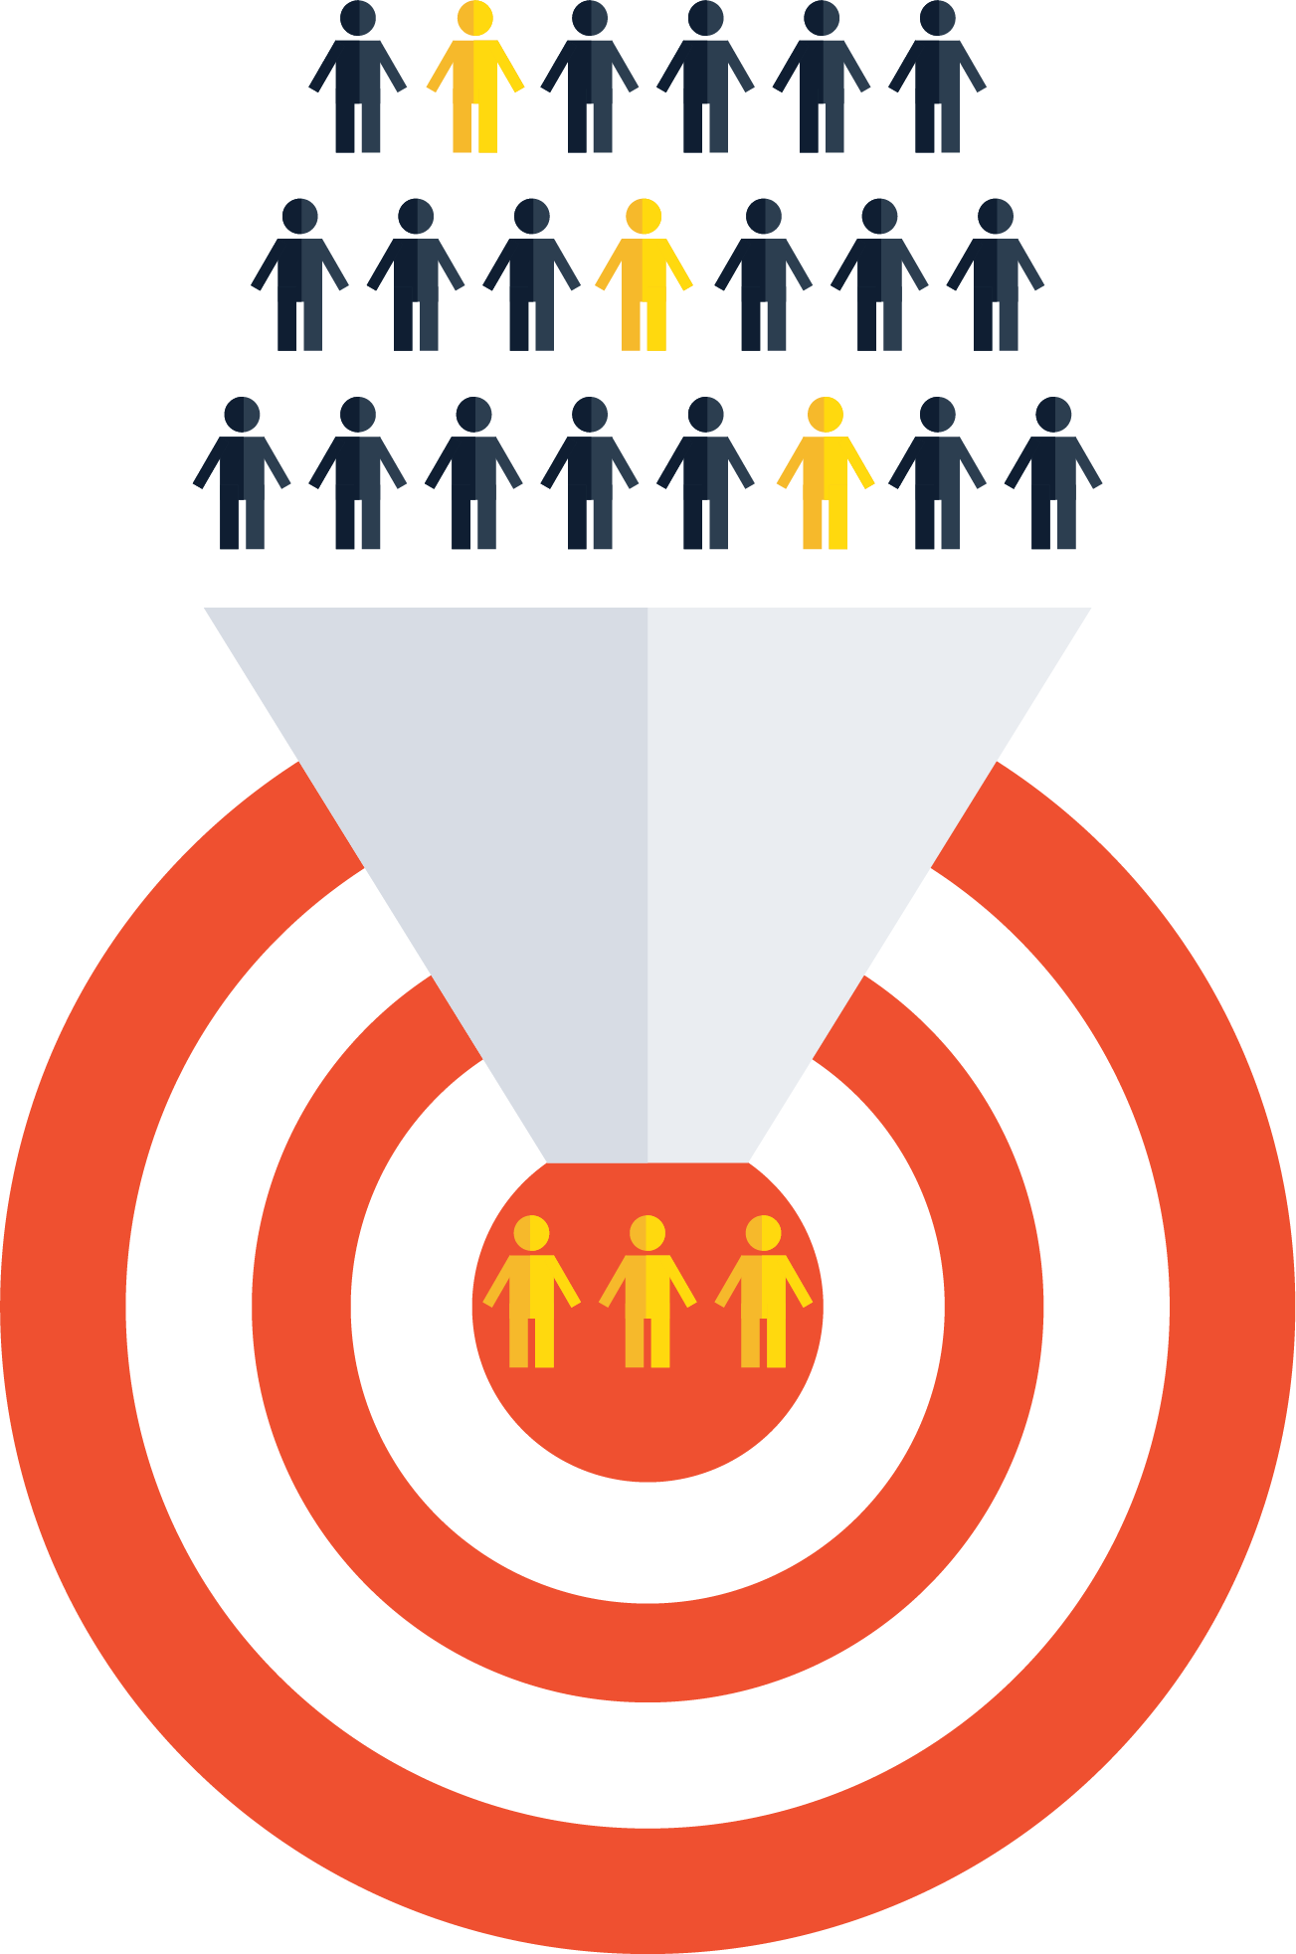
Unsupervised learning can be used to identify clusters, or related groups, of clients to target with product offerings or marketing campaigns.
Notes:
shutterstock_330221762

Slide 30
Introduction to Unsupervised Learning
The K-means algorithm is used for marketing use cases because of its ability to segment customers for more targeted ads.
Before K-means
After K-means
y
y
x
x
‹#›

Slide 31
Introduction to Unsupervised Learning
In the lesson:
In the Challenge assignment:
You’ll apply unsupervised learning by using the K-means algorithm to define customer segments, or clusters.
You’ll apply the K-means algorithm to cluster data and prepare a cryptocurrency portfolio proposal to the company’s board of directors.

Slide 32
the two most frequently used methods of machine learning are supervised learning and unsupervised learning.

Slide 33
Supervised vs. Unsupervised Learning
Supervised Learning | Unsupervised Learning
Input data is labeled. | Input data is unlabeled.
Uses training datasets. | Uses input datasets.
Goal: Predict a class or value. | Goal: Determine patterns or group data, called data clusters.

Slide 34
Challenges of Unsupervised Learning
Unsupervised learning comes with challenges:
Because the data isn’t labeled, we don't know if the output is correct.
The algorithm is creating its own categories for the data, so an expert is needed to determine if these categories are meaningful.
Even with challenges, unsupervised learning can be useful for a variety of applications, including the following customer segmentation tasks:
Grouping customers by spending habits
Finding fraudulent credit card charges
Identifying unusual data points (outliers) within the dataset

Slide 35
How might clustering be used by businesses?

Slide 36

One possible answer:
Clustering can be used to group customers by spending habits and create customized offers via email or mobile apps.
Notes:
shutterstock_490909516

Slide 37
How might anomaly detection be used by credit card companies?

Slide 38

One possible answer:
Anomaly detection can be used to detect potentially fraudulent credit card transactions by grouping transactions into “normal” or “abnormal.”
Notes:
shutterstock_1954985212

Slide 39
Clustering Explained
Notes:
4. Instructor Do: Clustering Explained (15 minutes)

Slide 40
Clustering is grouping data together so that every member of that group is similar in some way.

Slide 41
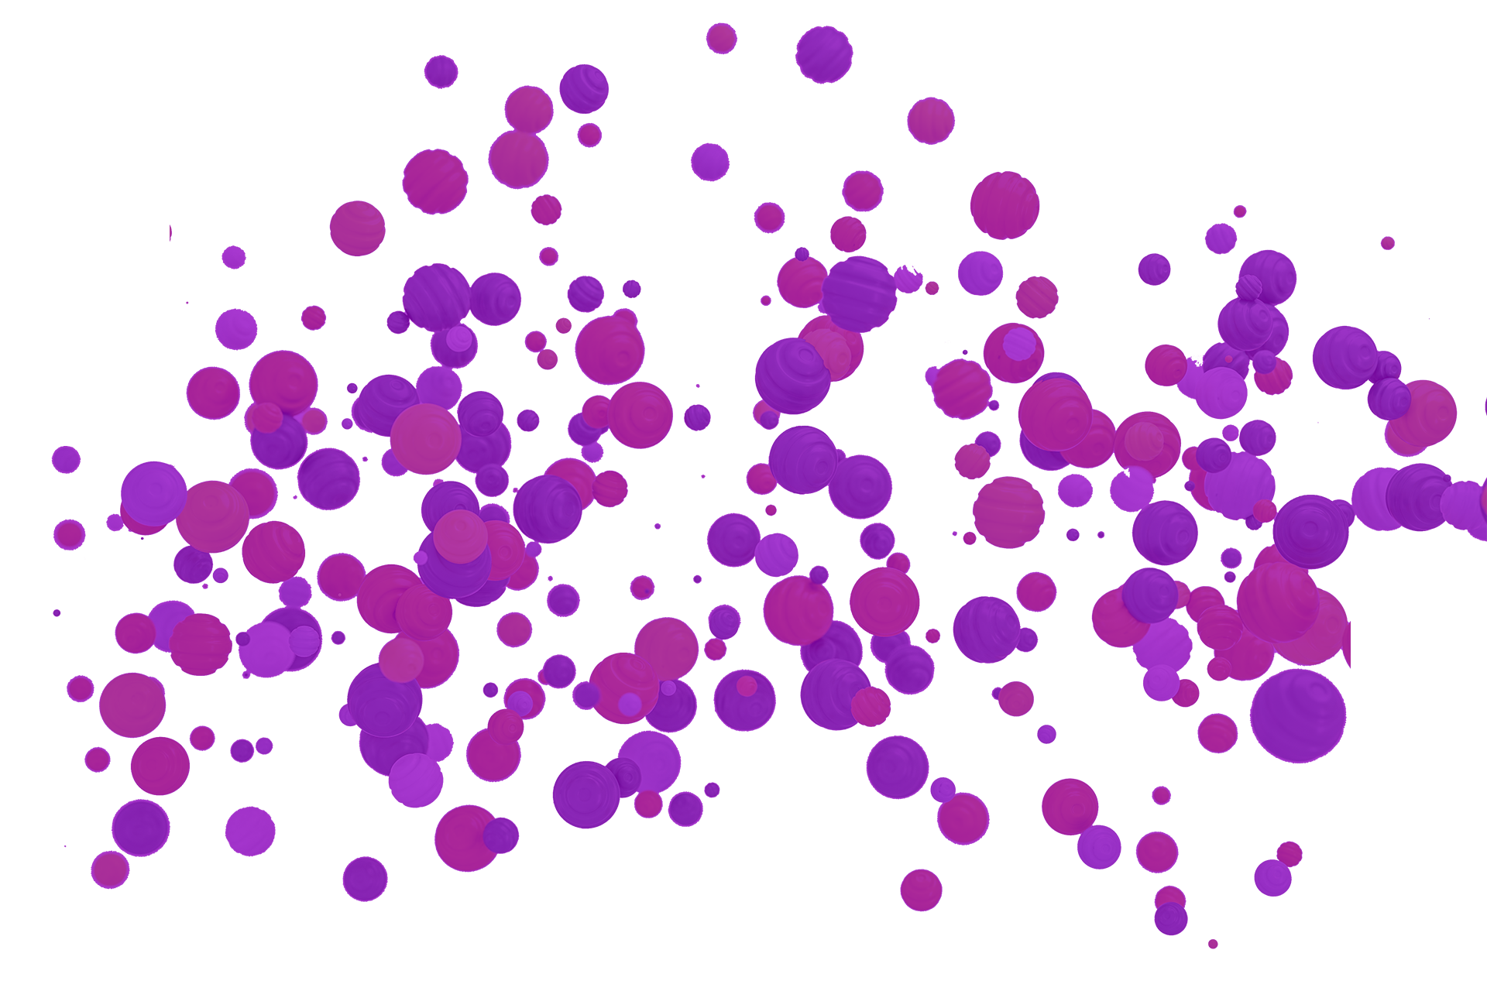
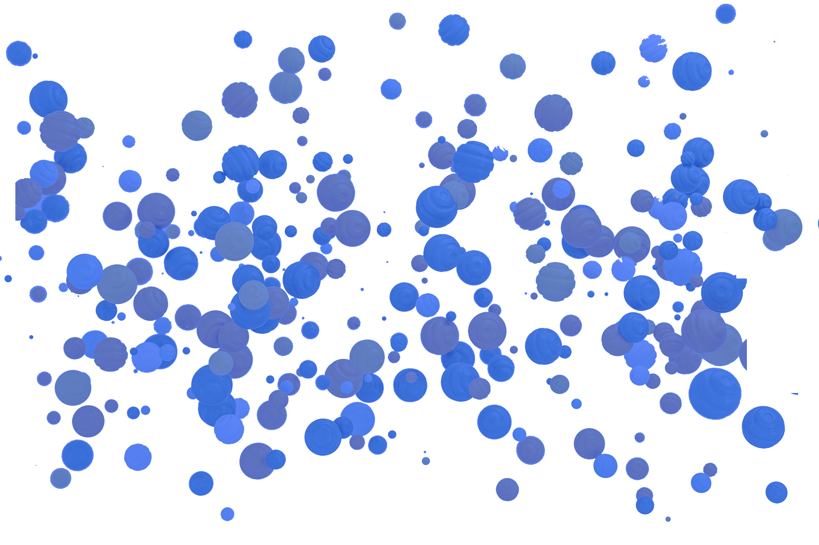
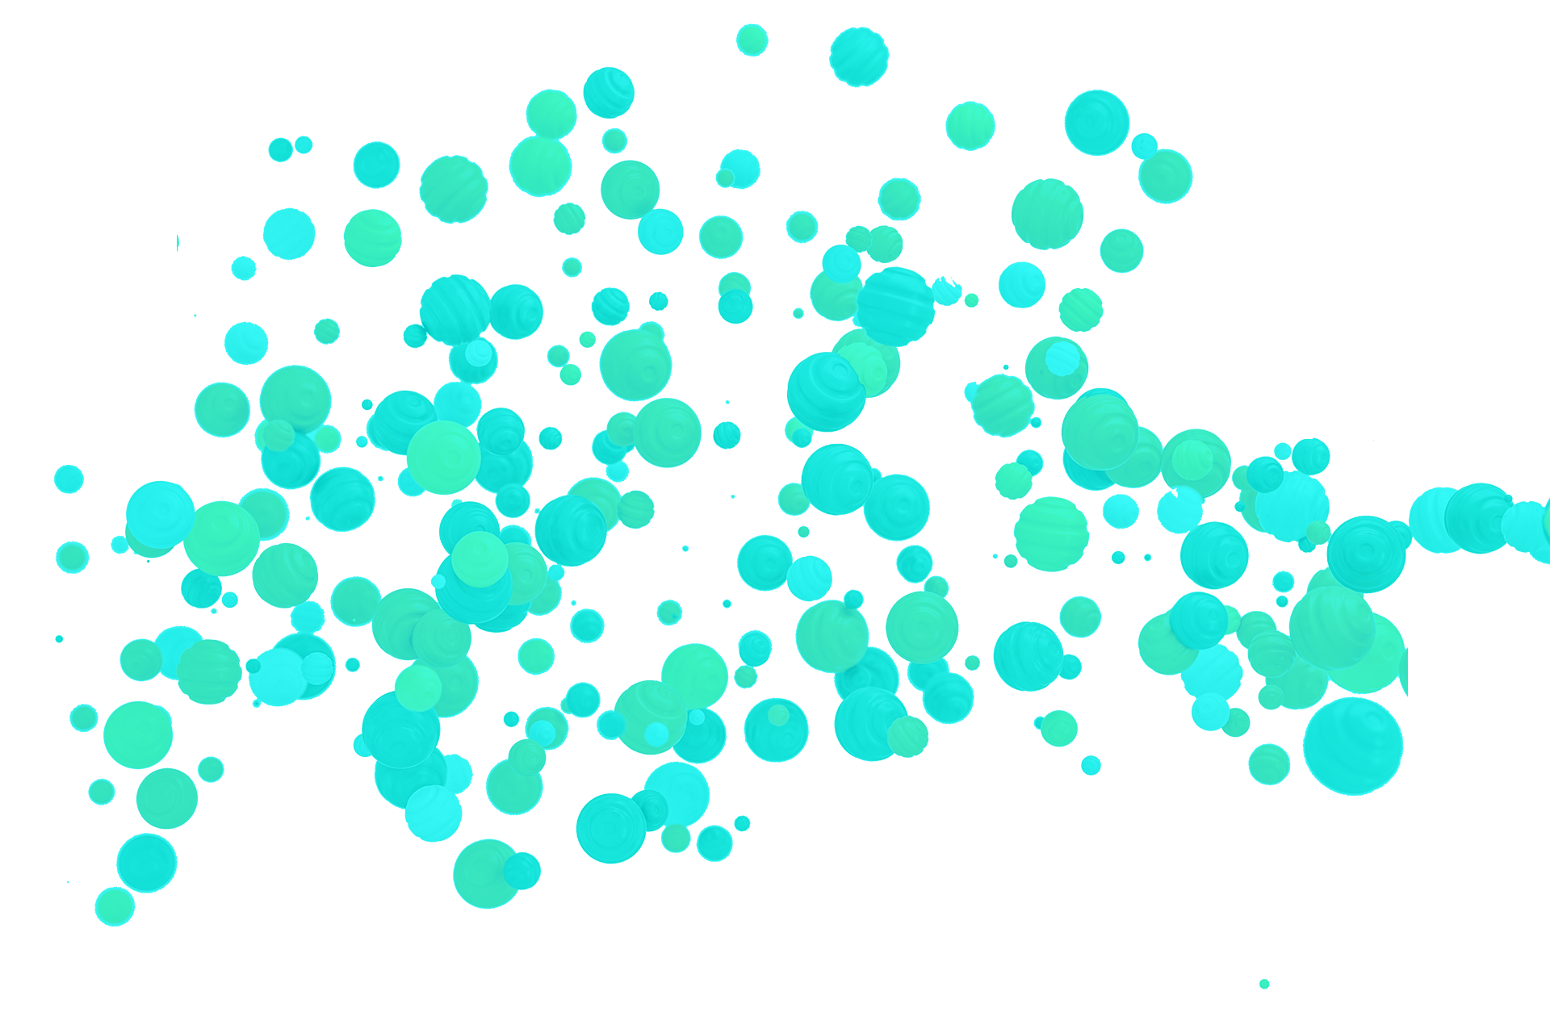
Clustering Explained
Unsupervised learning models are often created using a clustering algorithm.
80
60
40
50 60 70 80 90 100

Slide 42
Clustering Explained

Slide 43
Clustering Explained
The process of clustering data points into groups is called centering.
In advanced analytics, centering helps to determine the number of classes or groups to create.
Centering improves the performance of logistic regression models by ensuring that all data points share the same starting mean value.
Data points with the same starting mean value are clustered together.

Slide 45
The K-means Algorithm
15 Minutes
Notes:
5. Everyone Do: The K-means Algorithm (15 minutes)

Slide 46
The K-means algorithm is the simplest and most common algorithm used to group data points into clusters.

Slide 47
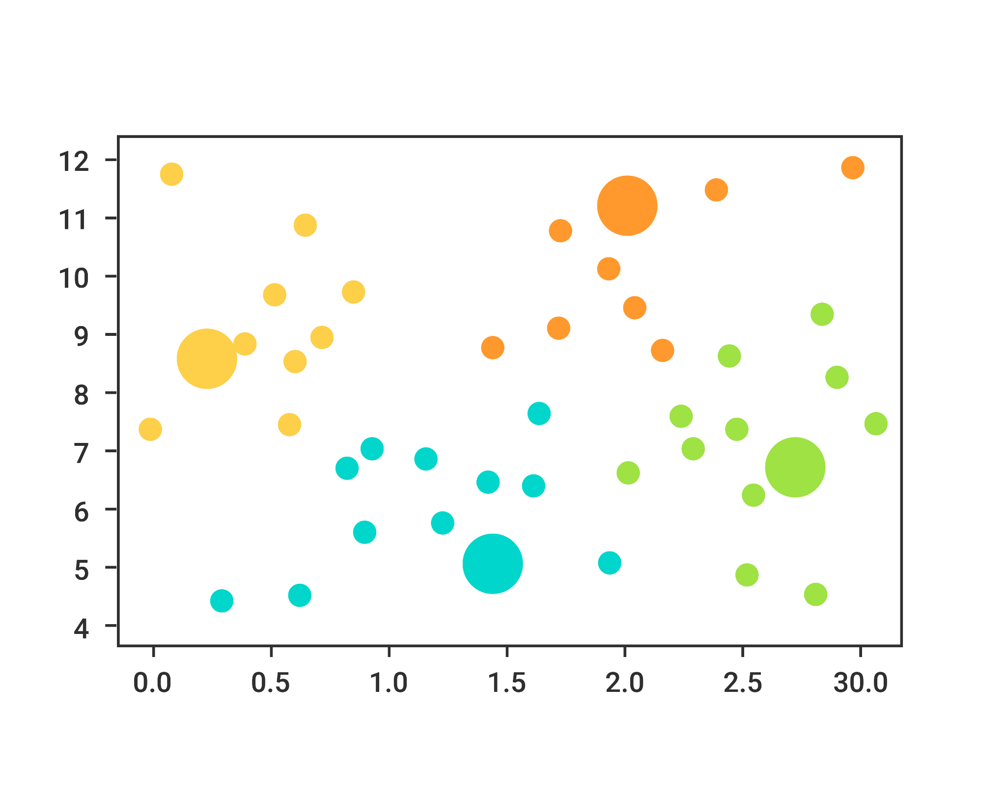
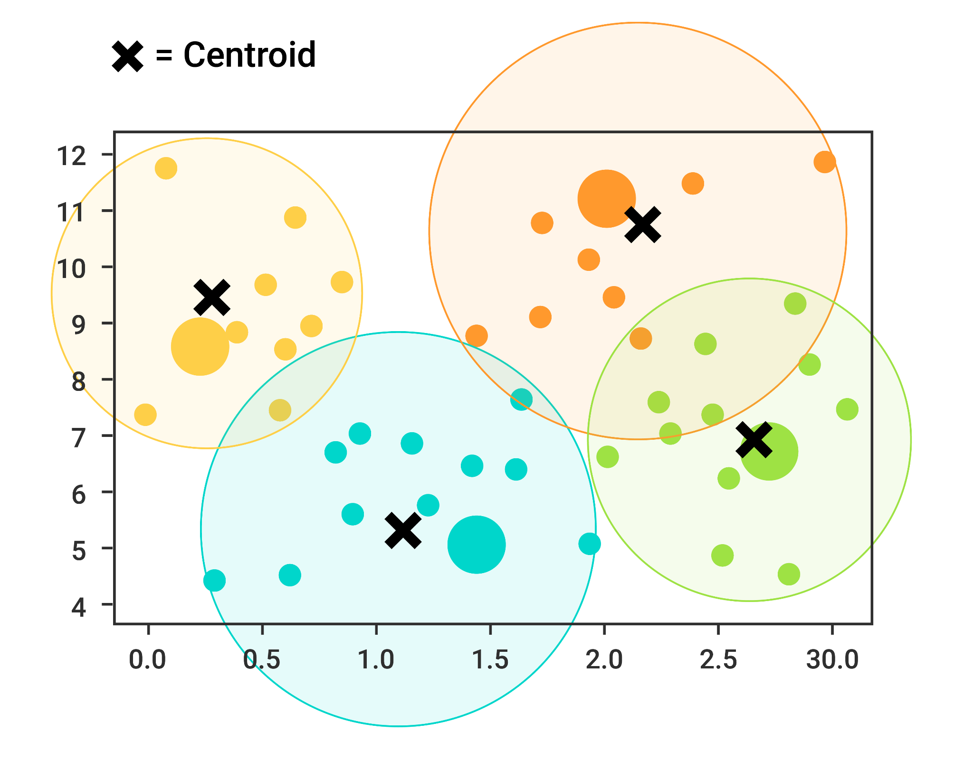
The K-means Algorithm
K-means takes a predetermined amount of clusters and then assigns each data point to one of those clusters.
The algorithm assigns points to the closest cluster center.
The algorithm readjusts the cluster’s center by setting each center as the mean of all the data points contained within that cluster.

Slide 48
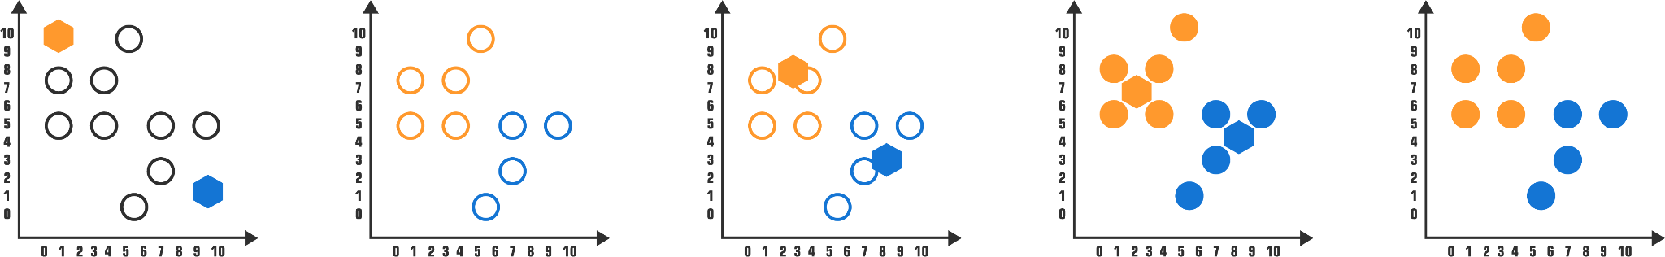
The K-means Algorithm
The K-means algorithm then repeats this process, again and again, each time getting a little bit better at separating the data points into distinct groups.
Randomly select K-clusters
Each object assigned to similar centroid randomly
Cluster centers updating depending on renewed cluster mean
Reassign data points; update cluster centers
Reassign data points
Notes:
shutterstock_1326927533

Slide 50
Activity: Segmenting Customers
In this activity, you will use the K-means algorithm to segment customer data for mobile versus in-person banking service ratings.
20 Minutes
Notes:
6. Student Do: Segmenting Customers (20 minutes)

Slide 53
Notes:
8. Break (15 minutes)

Slide 54
Introduction to Clustering Optimization
Notes:
9. Instructor Do: Introduction to Clustering Optimization (5 minutes)

Slide 55
Introduction to Clustering Optimization
The appropriate clustering algorithm and parameter settings depend on the individual dataset and intended use of the results.
Cluster analysis is not an automatic task.
As a data professional, you will need to do some trial and error to find the optimal clusters.
This process includes modifying the data preprocessing and model parameters until the result achieves the desired properties.

Slide 56
How do you know the optimal number of clusters, or value of k, and how do you find it?

Slide 57
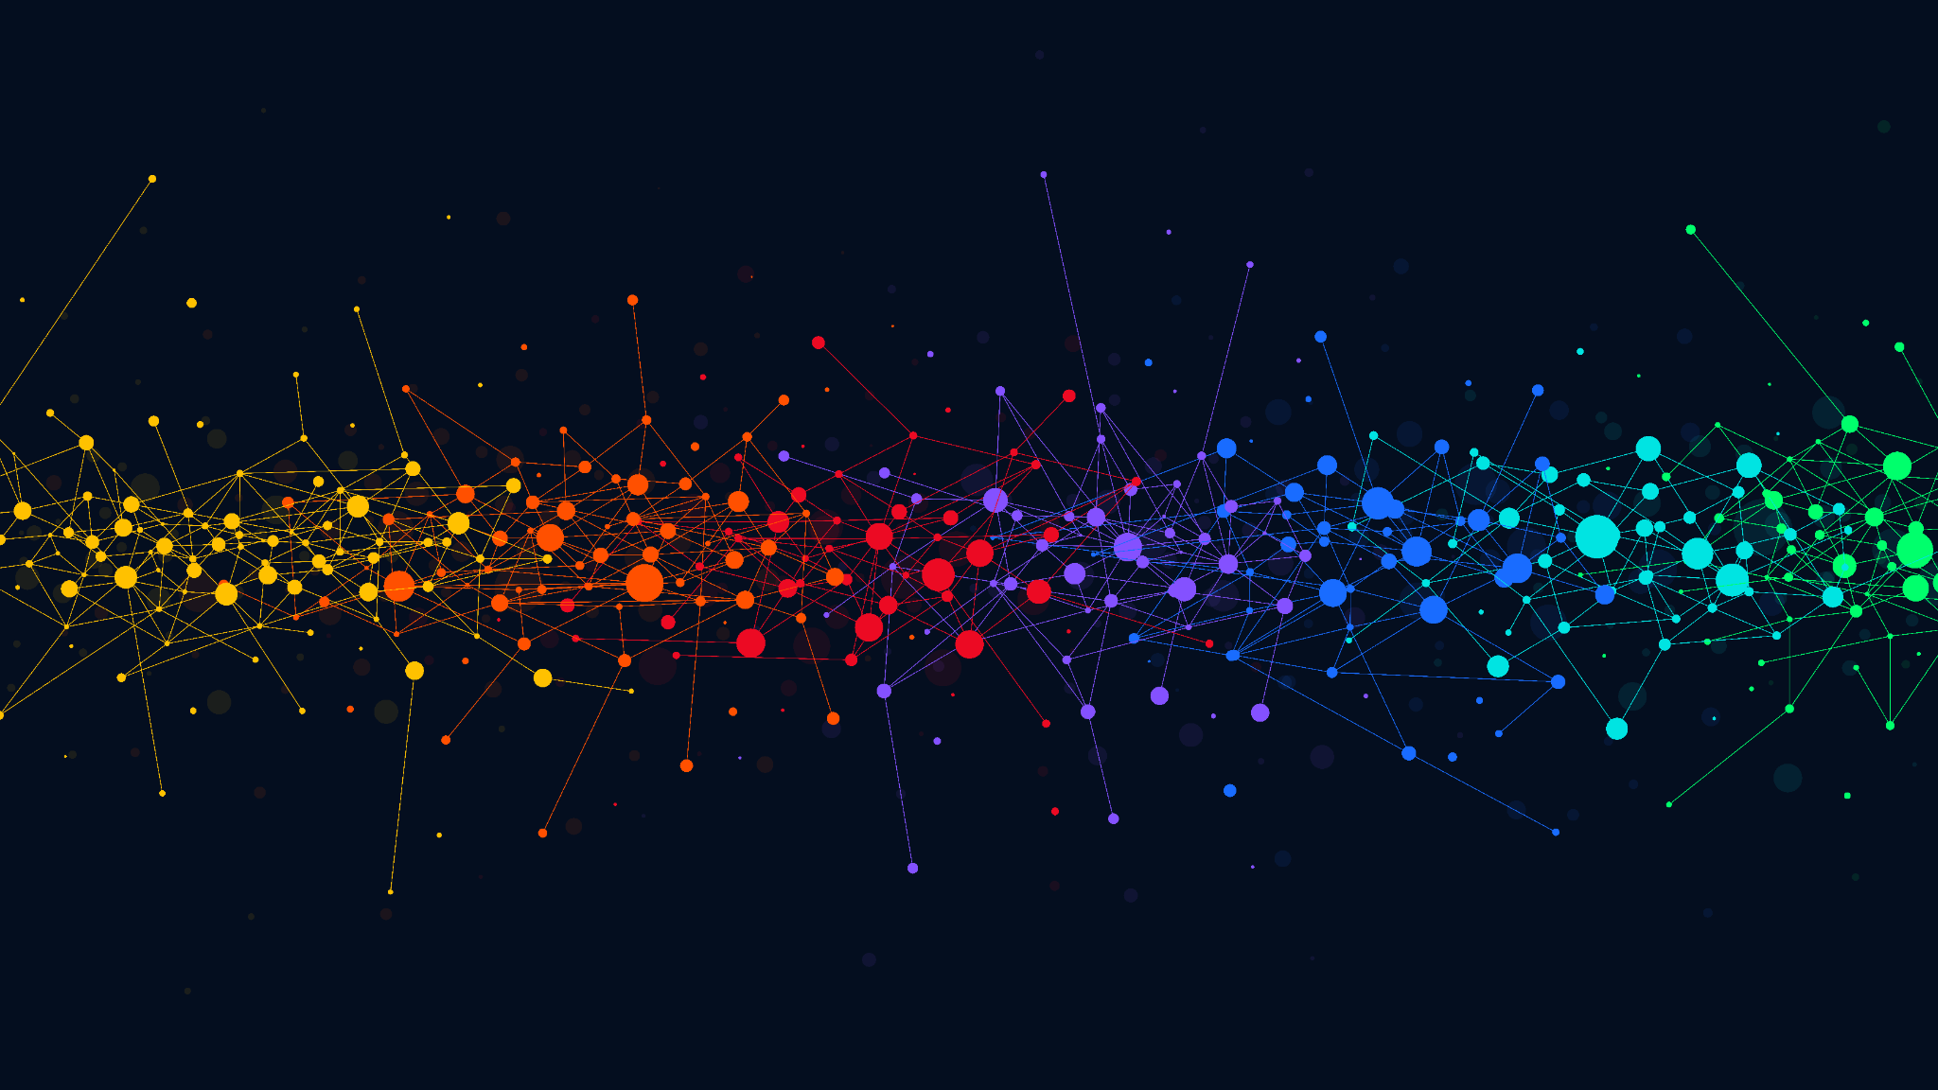
One of the challenges of working with unlabeled data is the unknown number of existing segments, or clusters.
Fortunately, a simple solution exists, called the elbow method.
Notes:
shutterstock_1962818785

Slide 59
The Elbow Method
Notes:
10. Everyone Do: The Elbow Method (20 minutes)

Slide 60
Since the K-means algorithm needs to have the amount of clusters provided ahead of time, how can you be sure that the amount of clusters you chose is correct?

Slide 61
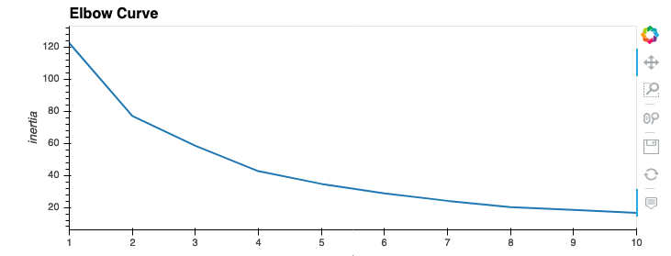
The Elbow Method
One method for determining the optimal value of k, or the number of clusters in a dataset, is the elbow method.
The elbow method runs the K-means algorithm for a range of possibilities for k, or the number of clusters.
The resulting elbow curve plots the number of clusters, x, versus an objective function called inertia.
Optimal value of k

Slide 62
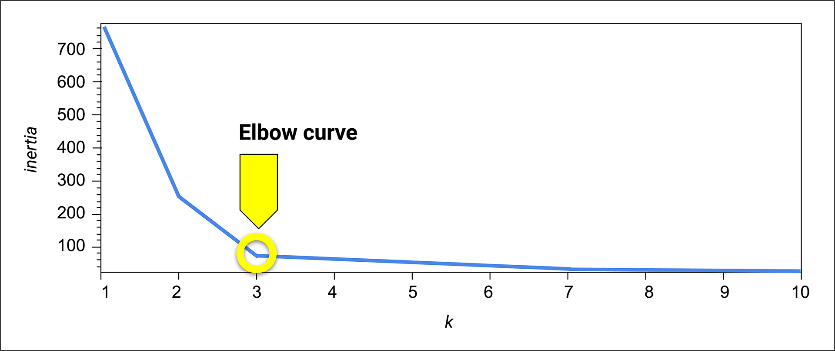
Elbow Curve
The elbow curve is commonly used to figure out the best value of k. It is essentially used to determine the number of clusters at which the data points become tightly clustered.

Slide 63
Elbow Curve
On the elbow curve, the x-axis is the value of clusters, while the y-axis is a metric used to assess the value of k.
y-axis
x-axis

Slide 64
Elbow Curve
The inertia is commonly used as an objective function. It is the sum of the squared distances of samples to their closest cluster center.
y-axis
x-axis

Slide 65
Elbow Curve
A low inertia value means that the data points are tightly clustered around the cluster center.
y-axis
x-axis

Slide 66
Inertia
Inertia involves complicated math, but it is basically a measure of how concentrated the elements are in a dataset.
High concentration
Low concentration
Datasets with a high concentration of elements (where elements are tightly grouped together) have a low inertia value.
Datasets with a low concentration of elements (where elements are spread out) have a high inertia value.
This means that there is a small standard deviation for the elements in the cluster relative to the cluster mean value.
This means that there is a high standard deviation for the elements in the cluster relative to the cluster mean value.

Slide 67
Low Inertia
High Inertia
vs.
Radius of circle is small = small standard deviation from cluster mean
Radius of circle is large = large standard deviation from cluster mean

Slide 68
The Elbow Method
The goal is to find a value for k that corresponds to a measure of inertia that shows minimal change for each additional cluster (or value of k) that is added to the dataset. The spot is indicated by the bend in the elbow.

Slide 69
The Elbow Method
20 Minutes
Notes:
10. Everyone Do: The Elbow Method (20 minutes)

Slide 71
Activity: Finding k
In this activity, you will use the elbow method to determine the optimal number of clusters that should be used to segment a dataset of stock pricing information.
25 minutes
Notes:
11. Student Do: Finding k (20 minutes)

Slide 72
Notes:
12. Instructor Do: Review Finding k (10 minutes)

Slide 75
Recap
Congratulations on acquiring your first machine learning skills! You can now:
Explain the differences between supervised and unsupervised machine learning.
Describe the purpose of clustering and how it’s used in data analytics.
Use the K-means algorithm to identify dataset clusters, and how to optimize this algorithm by using the elbow method.
Optimize the K-means algorithm by using the elbow method.

Slide 76
You will learn how to preprocess the data that goes into these types of models, and you’ll create models that can adapt and perform better on more complex types of data.

